Slide 1
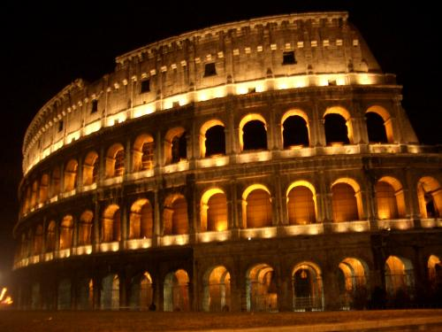
The legacy of Rome
Standard 6.7.8: Discuss the legacies of Roman Art and architecture, technology and science, literature, language, and law.

Slide 2
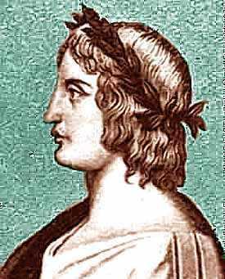
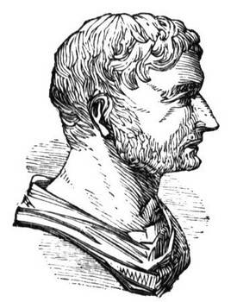
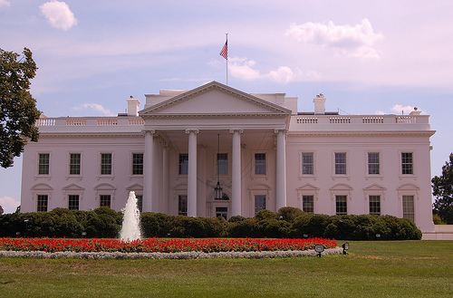
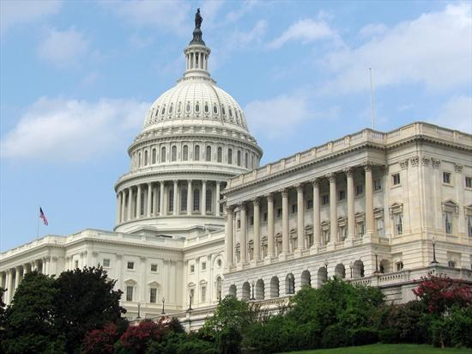
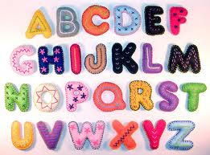
Rome’s Influences on Today
Culture
  Alphabet
  English words
  Roman writers: Virgil, Horace, and Livy
  Roman architecture

Slide 3
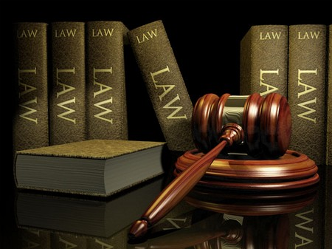

Rome’s Influences on Today (Cont.)
Government
  All people are equal under the law
  Innocent until proven guilty
  Citizenship
Christianity
  One of the major religions today

Slide 4
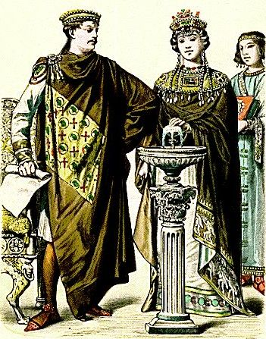
The byzantine empire
Standard 7.1.3: Describe the establishment by Constantine of the new capital in Constantinople and the development of the Byzantine Empire, with emphasis on the consequences of the development of the distinct European civilizations, Eastern Orthodox and Roman Catholic, and their two distinct views on church-state relations

Slide 5
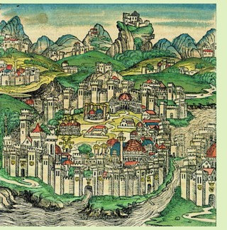
Constantinople (kahn-stan-tuhn-OH-puhl)
Capital of the Byzantine Empire
By 500s A.D. – one of the world’s great cities
Location
  Between Black Sea and Aegean Sea
  Secure land

Slide 6
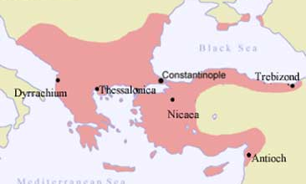
Map

Slide 7
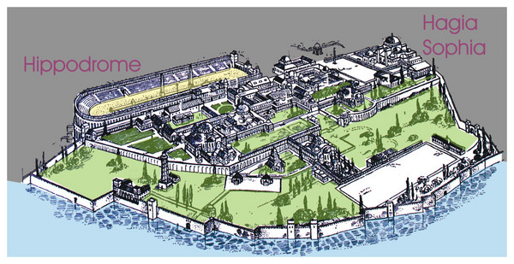
“New Rome”
Roman ways
  Buildings and palaces
  Hippodrome
Political
  Emperors spoke Latin
  Enforce Roman laws
Social life
  Poor: received free bread and shows
  Rich: lived in town or on large farming estates

Slide 8
Less Rome, More Greek
Most spoke Greek
  Emperors and officials
Other Influences
  Egyptians, Slavs, Persia
All cultures blended together to form the Byzantine civilization
Byzantines = one of richest and most advanced empires (500 A.D. – 1200 A.D.)

Slide 9
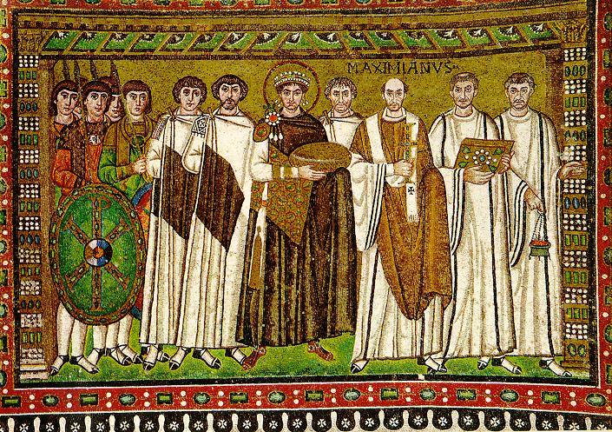
Emperor Justinian
527 A.D. – 565 A.D.
Strong Leader
  Controlled military
  Made laws
  Supreme judge

Slide 10
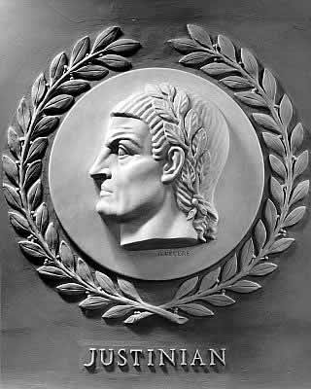
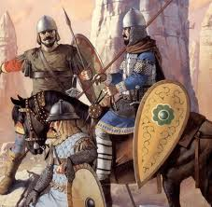
Justinian’s Conquests
Reunite the Roman Empire
General Belisarius (beh-luh-SAR-ee-uhs)
  Reorganized the Byzantine army
    Cavalry
    Armors
    Bows and lances
Conquered most of Italy, northern Africa, and Persia

Slide 11
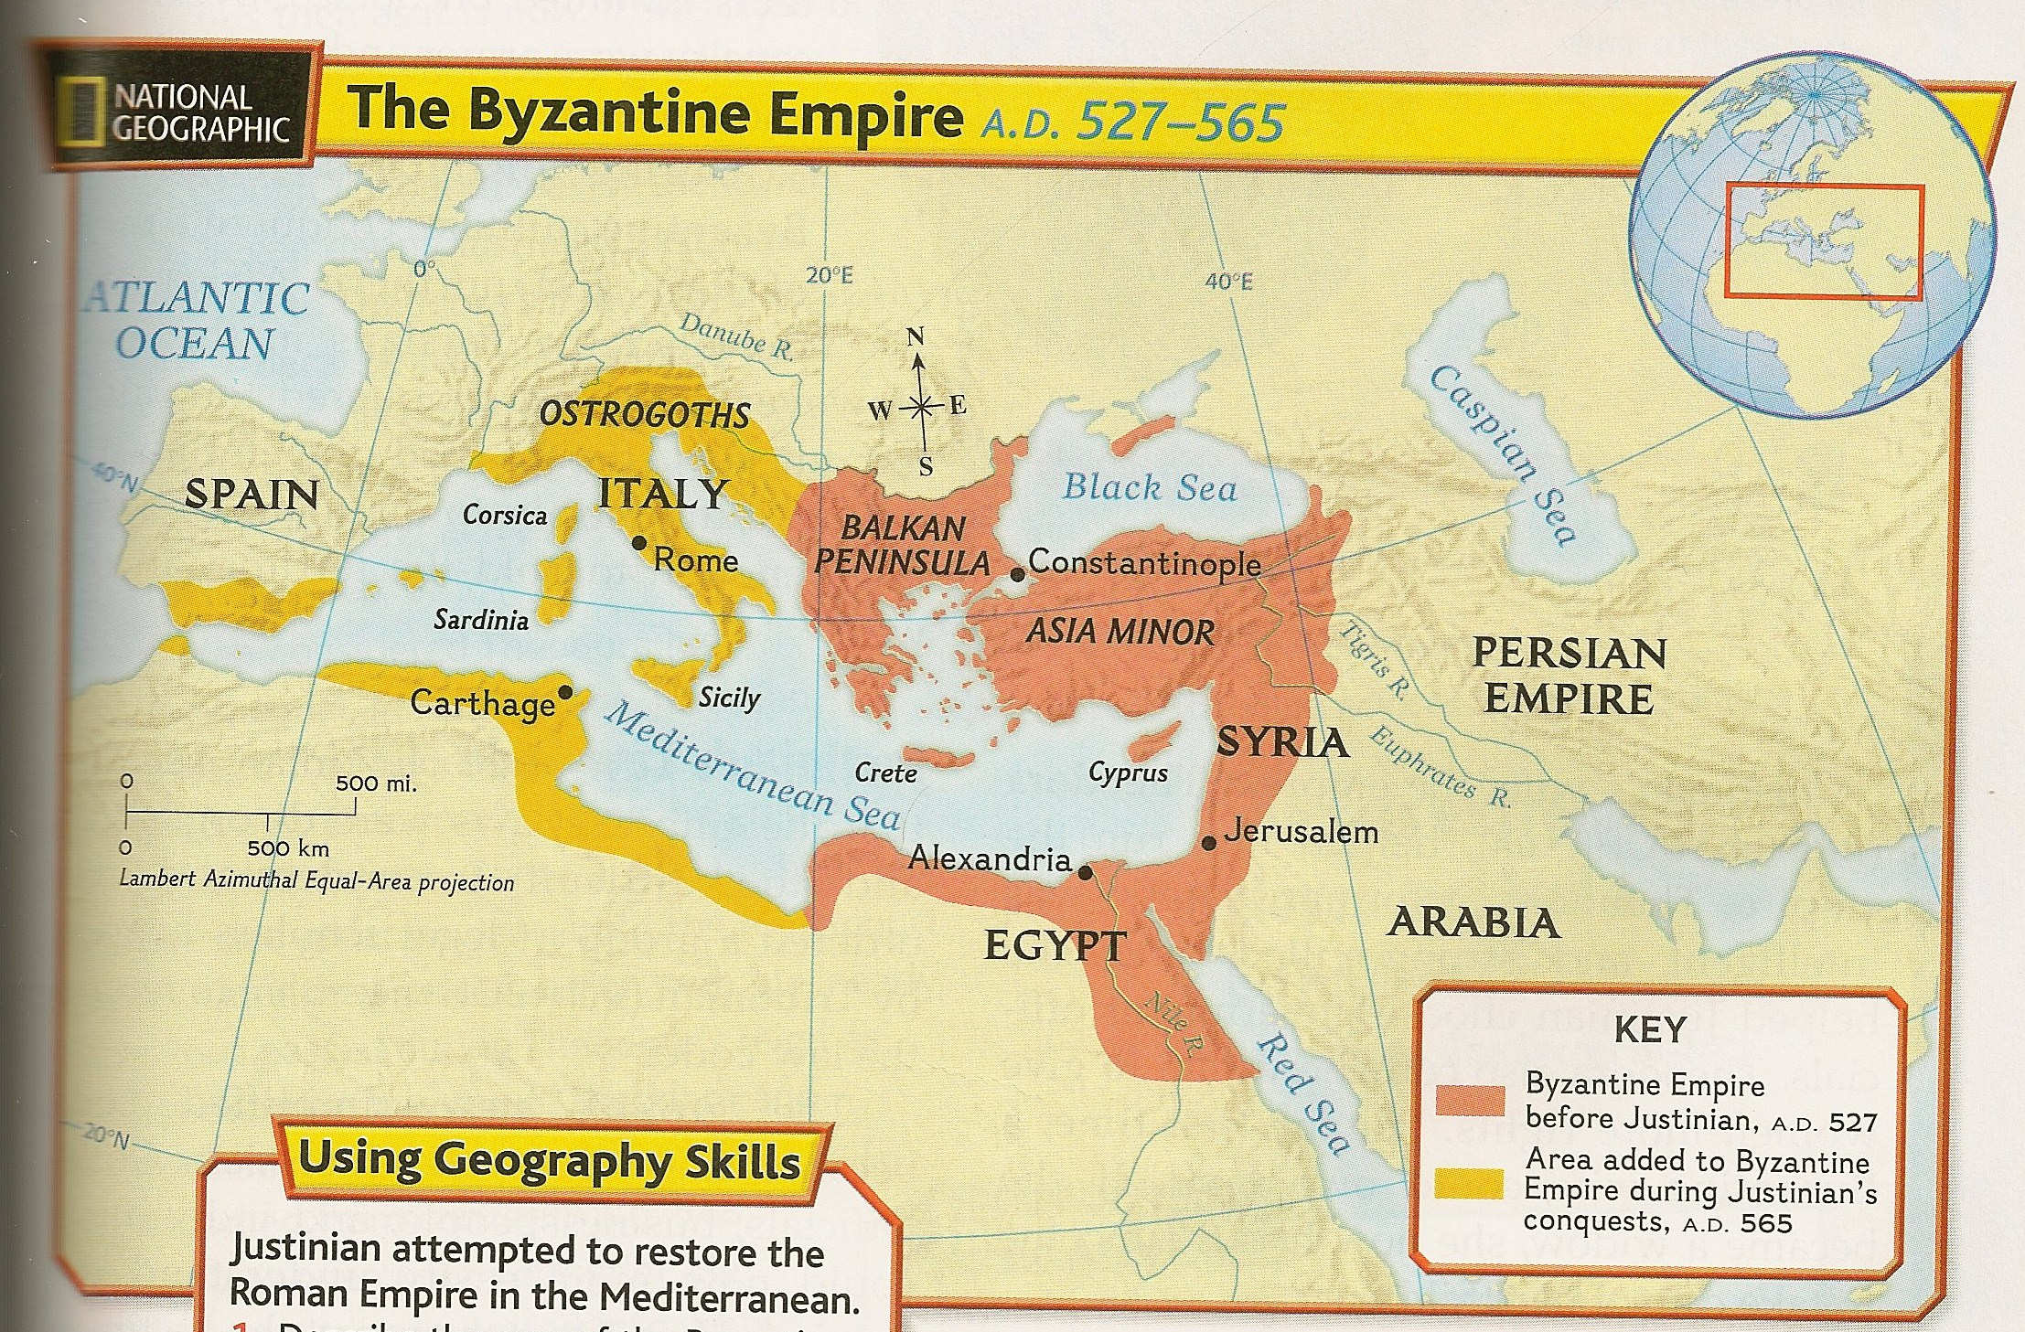
Map

Slide 12
Justinian Code
The empire’s laws were disorganized and hard to understand
Group of legal scholars
  Tribonian (truh-BOH-nee-uhn) to reform the law code
  Simplified code = Justinian Code
    Great influence on the laws of most country in Europe

Slide 13
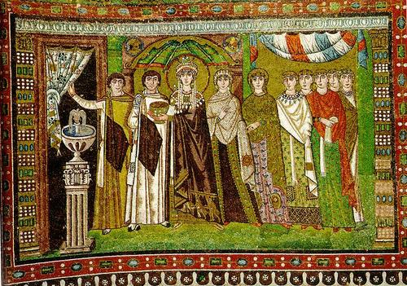
Empress Theodora
Wife of Justinian
  Former actress (lower class)
  Intelligent and strong willed
Justinian’s intellectual equal
  Asked for her advice: laws and policies
  Help choose government officials

Slide 14
Empress Theodora (cont.)
Women’s Rights
  Property ownership
  Divorce
  Gave mothers some guardianship rights over their children
  Forbid the killing of a wife who committed adultery
Helped save Justinian’s throne

Slide 15
Byzantine civilization

Slide 16
Trade
From 500s A.D. – 1100s A.D.
  Center of trade
    From Asia: spices, gems, metals, and cloth
    Byzantine merchants: farm goods, furs, honey, and enslaved people from northern Europe
Enormous trade = Wealthy empire
  Silk weaving
    Developed around 550 A.D.
    Smuggle silkworm eggs out of China

Slide 17
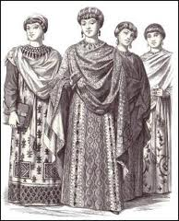
Women
Family = center of social life
Expected to stay home and take care of their family
Some became well educated
  Involved in politics
  Royal women served as regent
  Regent – a person who stands in for a
    ruler who is too young or ill to govern

Slide 18

Education
Highly respected
Government support
Authors wrote about religion
  Obey God
  Lives of saints
Byzantine writers copied and passed on the writings

Slide 19
Education (cont.)
Boys
Girls
Religion, medicine, law, arithmetic, grammar, and other subjects
Hired tutors
Did not attend school
Taught at home

Slide 20
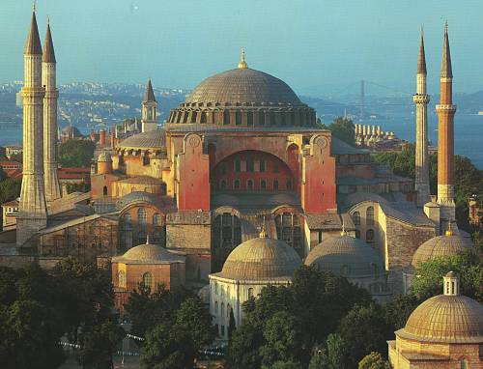
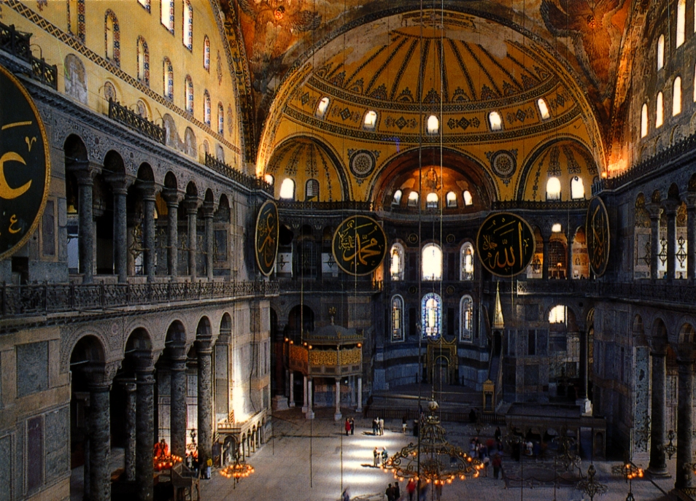
Architecture
Buildings throughout the empire
Constantinople: hundreds of churches and palaces
Hagia Sophia = “Holy Wisdom”
  Completed in 537 A.D.

Slide 21
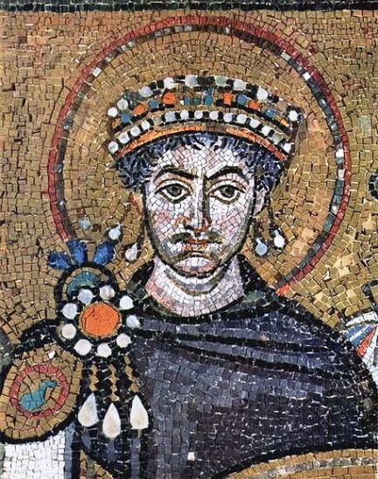
Art
Mosaics – pictures made from many bits of colored glass or stone
  Saints or Christian holy people
  Bright and rich colored
  Decorated
    ceilings, domes, and floors of churches
  Expensive

Slide 22
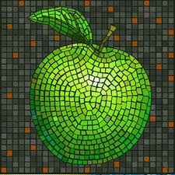
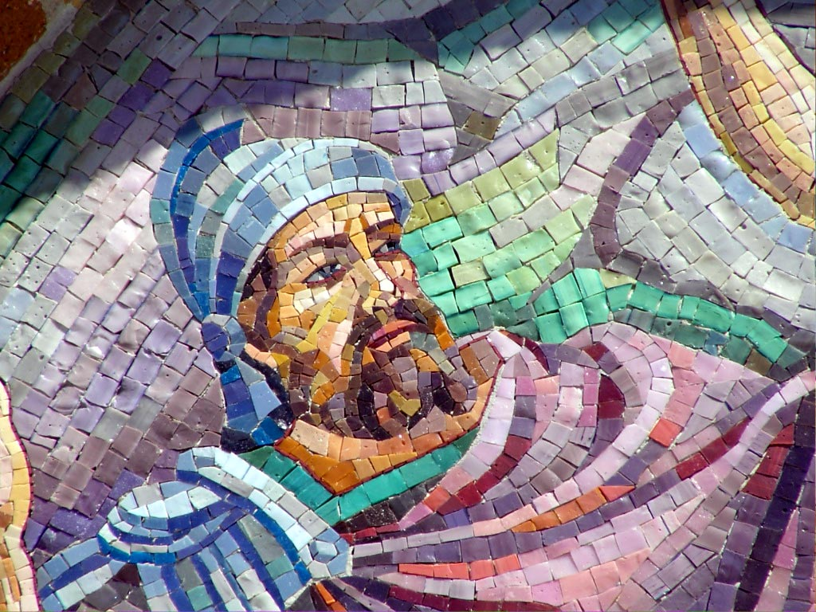

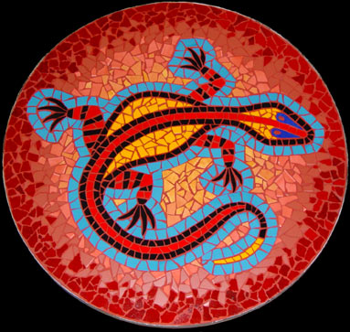

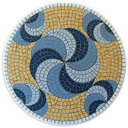
Mosaics

Slide 23
Questions?
Map: Constantinople, Byzantine Empire (?)
Activity Time! ☺

