Slide 1
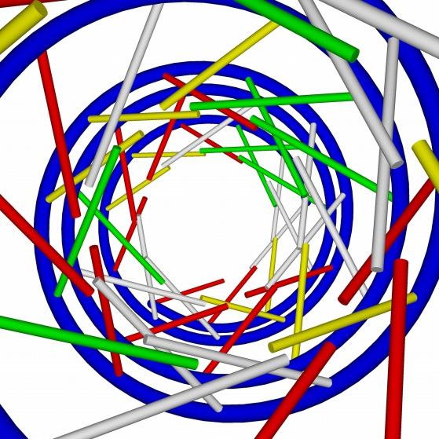
The Communication Process
A Complicated Matter
ByMar Global
Dr. Marquita Byrd, President
Copyright ByMar Global

Slide 2
Importance of Communication theories
Critical thinking skills
recognize depth and breadth of research
make meaning of personal experience
self awareness
Better Understanding of life in general

Slide 3
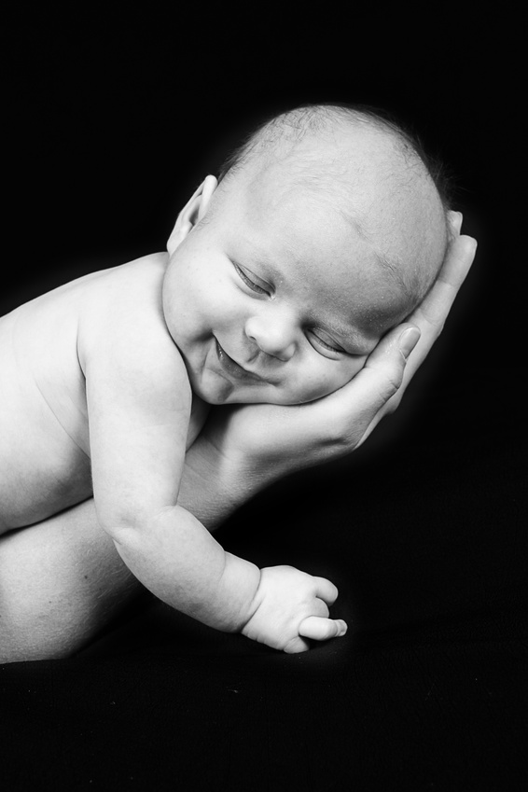
Reproductive Journey
The journey from Conception to Birth is A Miracle

Slide 4
Communication: A Reproductive Journey of Thoughts
So complex that any problem along the way can lead to miscommunication.
* Miscommunication is not the cause of most conflicts. The cause is most often REAL differences among the communicators. They understand each other they just don’t agree.

Slide 5
Communication is the Creation and Sharing of Meaning
Talking and experiences create meaning”
Sending and receiving messages is a mechanistic way of describing it.

Slide 6
Communication Scholars Study Messages and their…
Antecedents (before)
Consequences(after)
Contexts(where and when)
Functions(why)
Levels(relationships)

Slide 7

Functions
Mental Processes
Socialization
Persuasion
Others
Self
What something does or it’s purpose

Slide 8
Levels of Communication
Organization
Cross-Cultural
Mass media
New Media
Interpersonal
Intrapersonal
Person-persons
Small Group

Slide 9
Three
Define and explain
Linear
Interactional
Transactional

Slide 10
Thee Models of Communication
Define and explain
Linear
Interactional
Transactional

Slide 11
Interactional Model of Communication
Communicator
Encode
Filters
Channels
Message
Noise
Communicator
Decode
Feedback
Context

Slide 12
Sending and Receiving
Receiving
Sending
Destination of a message
Origin of a message

Slide 13
Channels of Communication
Are the Means by Which we Make our Messages Known
Auditory
Sound Waves
Visual
Light waves
Tactile
Pressure on the skin
Olfactory
Odor Molecules
Gustatory
Chemicals stimulating the lingual and sublingual nerves
Technology
Mechanical means

Slide 14
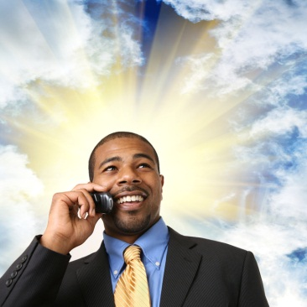

Encoding-Decoding
Talking or texting a message
Making our message understandable to another person
Encoding
Decoding
Listening or reading a text message
Interpreting the Message: Determining what it means

Slide 15

Noise
Anything that interferes with the message”
Physical
or psychological
(differences in attitudes, experiences, information overload, distorted filters, mental fatigue)

Slide 16
Psychological Filters
Filters include all of our experiences, formal and informal education, attitudes, beliefs, gender, age, health, etc.
Everything that we do and everything that we experience is shaped by our filters.
Filter: something that keeps things in or keeps things out.
Sorts things

Slide 17
Feedback
Any response to the message. “
Determine if message was received and understood
Validate the other
Indicate that one is a member of the group
Even silence or no response is a response.
Feedback Loop

Slide 18
Ethics
Guidelines for Behavior
Where do they come from?
Discuss ethics in business, religion, entertainment, education, medicine politics, technology

Slide 19
Communication is complex
Many working parts
Moving at the same time
Simultaneity
Each communicator brings a different set of experiences
Encoding-Decoding
Sending-Receiving
Simultaneously

Slide 20
Every child born without a birth defect is a miracle!
The journey from Conception to Birth is A Miracle

Slide 21
Every communicative event that ends with a shared understanding, and the communicators have a reasonable facsimile of what the other means, is a miracle.
Get definition of “facsimile”

