Slide 1
SJSU
School of Social Work
Field Education Program
Field Instructor Orientation

Slide 2
Orientation Schedule
8:00-8:15 Registration & Refreshments
8:15-10:15 Introduction, Nuts & Bolts of Field Education, and Student Assignments
10:15-10:30 Break
10:30-11:30 Structuring and Conducting Successful Supervision and Phases of Internships
11:30-12:00 Managing Challenging Students and Agency Environments
12:00-1:00 Panel: Field Instructors, Faculty Field Liaisons, Student, Professor Sen
Notes:
Move around and get food, stretch, etc.
Where the bathrooms are
Questions throughout
Why we are combining MSW and BASW
Ambitious Agenda

Slide 3
Orientation Agenda & Topics
Introduction
  Welcome
  CSWE Competencies
  SJSU School of Social Work Mission & Field Education Overview
  Transcultural Perspective and Theoretical Frameworks
  Expectations of Students
  Nuts & Bolts of Field Education
  Field Education Overview/BASW and MSW Overview
  Student Assignments
  Role of the Faculty Field Liaison (FFL) and Field Education Office
  IPT (Intern Placement Tracking system)
Successful Supervision and Developmental Phases of Internship
  Roles of the Field Instructor (FI)
  Boundaries and Successful Supervision
  Developmental Phases of Internship
Managing Challenging Students and Agency Environments
  Common Experiences and Strategies
  Hints & Tips for New FIs (Field Instructors)
Panel: Field Instructors, Faculty Field Liaisons, Student, and Dr. Sen
  Presentations, Questions and Wrap-Up
Notes:
Move around and get food, stretch, etc.
Where the bathrooms are
Questions throughout
Why we are combining MSW and BASW
Ambitious Agenda

Slide 4
CSWE Competencies in Field Education
Field Education is guided by ten competencies outlined by CSWE
Learning Agreements must reflect these competencies
Learning activities should be informed by these competencies, be specific, and measureable
Evaluations must measure progress on skills and knowledge in relation to these competencies

Slide 5
Ten CSWE Competencies
Identify as a professional social worker and conduct oneself accordingly
Apply social work ethical principles to guide professional practice
Apply critical thinking to inform and communicate professional judgments
Engage diversity and difference in practice
Advance human rights and social and economic justice
Engage in research informed practice and practice informed research
Apply knowledge of human behavior and the social environment
Engage in policy practice to advance social and economic well-being and to deliver effective social work services
Respond to contexts that shape practice
Engage, assess, intervene, and evaluate with individuals, families, groups, organizations, and communities

Slide 6
Developing competence through multiple iterations of:
Practice/Action
Reflection
Critical Thinking
Analysis of Practice/Conceptualization
Observation and Feedback
Further Opportunities for Practice/Action
                (Bogo, 2010)

Slide 7

Mission
The mission of the School of Social Work at San José State University is to prepare social work professionals for effective, ethical practice and leadership from a transcultural perspective with diverse individuals, families and communities.

Slide 8
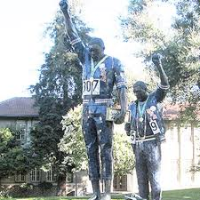
Field Education, Trans-Cultural & Theoretical Perspectives Overview
“Action indeed is the sole medium of expression for ethics” – Jane Addams

Slide 9
Purpose of Field Education
Learning through delivering a social work service in a practice setting under the tutelage of an experienced social worker (Bogo, 2005). Field practicum affords the opportunity to validate, apply and integrate the knowledge, theories, and concepts of social work practice being learned throughout the curriculum.
The student is engaged in experiential learning, which requires him/her to bring together and to integrate for professional use: cognitive learning; skills and knowledge; professional values; and experiential activities, which will enhance his/her skills in, and critical analysis of social work practice.
Notes:
Dynamic tension of doing a job before being fully trained for it.

Slide 10
Field Education
Social work education embraces the concept that students learn best when they are involved in the experience of integrating theoretical concepts taught in the classroom and employing them in internships.
Students engage in understanding the importance of establishing professional relationships with their clients, the significance of assessment, determining goals in collaboration with clients, developing effective intervention strategies, evaluating their services, and demonstrating a greater sense of self awareness that informs practice.

Slide 11
5 Elements of the Transcultural Perspective
Cultural Knowledge
Cultural Competence
Power, Privilege, Oppression & Structural Contexts
Positionality & Self-Reflexivity
Respectful Partnership
The Transcultural Perspective
Notes:
Model of working with diversity. How do you transcend your own culture?
1. Emphasizes the importance of understanding concepts and processes related to
culture and how these intersect with social work concerns. All human beings operate in cultural
Contexts.
2. draws upon the cultural knowledge and applies it to practice with specific groups. The primary focus of this dimension is on
culturally responsive doing, or the ways in which social workers effectively apply cultural
Knowledge
3. dynamic of power relations in the larger society and how those dynamics are reflected in the practitioner-client relationship and the ways in which practitioners
approach, analyze, and address social work issues, problems, and contexts. The dynamic of power
shifts based on the social location and position of practitioners and clients and the larger historical
and sociopolitical context and skills to different cultural communities and contexts.
4. how ones social location, or positionality, influences her/his world view, behavior, research practice, and professional action. it involves the ability to understand how ones own life experiences shape perceptions of clients and client systems, consider how meaning and
identities are co-created through the interactions between the self and others.
5. adopting an approach to working across cultures that is characterized by a spirit of inquiry and collaboration

Slide 12
8 Theoretical Perspectives
Systems
Conflict
Rational Choice
Social Constructionist
Psychodynamic
Developmental
Social Behavioral
Humanistic
Chapter: Theoretical Perspectives on Human Behavior
  http://www.sagepub.com/upm-data/36524_PE_Chapter2.pdf

Slide 13
Some Examples of How to Integrate Classroom Learning into Field Instruction:
The intern reflects on an individual and/or family and identify and describes the different elements of Systems Theory that are relevant (subsystems, boundaries, differentiation, equifinality, etc.).
Once the intern identifies relevant theory(ies), the intern develops and implements specific strategies that be can employed to integrate the theory(ies).
The intern reviews the 8 theoretical perspectives, and gives descriptive examples of how each theory may be relevant to their caseload, the organization, and/or the community.
In supervision, the intern is asked to examine dynamics of power, privilege, and oppression in the field setting, and its effects on the individuals and systems involved.

Slide 14
Evidence-Based and Evidence-Informed Practice
Evidence-Based Practice
Evidence-Informed Practice
The “...conscientious, explicit, and judicious use of current best evidence in making decisions about the care of individual [clients]" (Sackett et al., 1996, p.71). The steps include:
1. Formulating a client, community, or policy-related question
2. Systematically searching the literature
3. Appraising findings for quality and applicability
4. Applying these findings and considerations in practice
5. Evaluating the results
(CSWE)
Involves obtaining evidence from multiple sources to inform assessments and interventions, which can include (but is not limited to):
One’s own and colleagues’ practice experience and wisdom
Professional values and ethics
Policies (multiple levels)
Knowledge from clients, client systems, and communities

Slide 15
Field Expectations of Students
Students are self-directed learners, actively involved in their education. Students conduct themselves professionally at all times. They are learners, and are expected to make and learn from mistakes.
Students to contact FI to report absence from field .
Make arrangements make up missed time.
Absences over 3 days or excessive reported to the Faculty Field Liaison.
Notes:
If questions, check with FFL – what’s not included (Thanksgiving, Spring Break)

Slide 16

Nuts & Bolts of Field Education

Slide 17

Program Overview (School)
BASW Generalist Program
MSW Program & Fields of Practice
Credentials/Certificates/Stipends
  Assignments & Caseload Expectations
Updates
Faculty Field Liaison Roles
IPT

Slide 18
BASW Program
Generalist Model
2 year program starting in the Junior year (60+ units)
38 units of Social Work courses

Slide 19
MSW Program
63 Units of Social Work courses
2 or 3 year programs
1st Year is Generalist
    Transcultural Perspective
    Multi-systems
2nd or Final Year is more specialized:
  Three Fields of Practice
    Aging; Children, Youth & Family; Health & Mental Health
    Higher level of competence

Slide 20
Additional Credentials/Certificates/Stipends
BASW
Mental Health Stipend Program (Stipend/Training)
MSW
PPSC (School Social Work)
Title IV-E (Child Welfare Stipend/Training)
MHIP (Mental Health Stipend/Training)
Gerontology Certificate
Spanish Certificate
Notes:
Will be discussed in more specifics later

Slide 21
Minimum Hours Requirements
  BASW & First-Year MSW students:
    480 hours for the academic year (16 hours/2 days per week/224 fall – 256 spring)
  Final-Year MSW students:
    720 hours for the academic year (24 hours/3 days per week/344 fall – 376 spring)
  BASW students: 480 total hours
  MSW students: 1200 total hours

Slide 22
Field Practicum
Days in the Field
  BASW students:
    Tuesday/Thursday
  First-year MSW students:
    Tuesday/Thursday
  Final-year MSW students:
    Wednesday, Thursday, Friday

Slide 23
Placement Procedures & Website Resources
Placement Procedures
  BASW
  Final-Year
    General, PPSC, Title IV-E, MHIP
  First-Year MSW
    Overall philosophy
http://www.sjsu.edu/socialwork/currentstudents/internships/
Notes:
Due Process Docs
When web site will be updated

Slide 24
Supervision Requirement & Caseloads
Supervision
  A minimum of one hour per week per student of formal individual supervision and informal consultation as needed. Informal supervision is also required.
Caseload Expectations
  Reflects a workload that supports student learning with appropriate time to process their learning and also complete any necessary paperwork and work on community projects and 298 (MSW) if applicable.

Slide 25
BASW Assignments
Learning Agreement: With FI and FFL, complete learning agreement (first semester)
Journal Assignment:
  A weekly journal is required. The journal provides an opportunity to think critically about, and reflect, on your learning. Each week the journal should include a summary of the activities you have engaged in, the link between the activities and classroom learning, and your thoughts and reactions to your learning. In addition, any challenges you face, highlights of the internship, and questions you have should be included. In the final journal entry for each semester you should reflect on the progress you have made toward your educational goals. Each journal entry is expected to be about 1 page and must be submitted on a weekly basis.
Process Recordings: Complete process recordings on assigned cases or group recording as determined by the FI. A minimum of one process of recording per semester is required

Slide 26
BASW Assignments
Professional Activities: Participate in professional activities such as staff meetings, agency, community trainings as available
Participate in group supervision, consultations, and case presentations.
Field Evaluations: with FI and FFL, participate in and complete all field evaluations.

Slide 27
BASW Learning Agreement
http://www.sjsu.edu/socialwork/currentstudents/internships/basw/

Slide 28
BASW Caseload Expectations
Fall semester:
  Minimum of 3 individual cases
Spring semester:
  Minimum of 5 individual cases
Caseload may vary depending on population
May also consider mezzo/macro “cases” such as families, groups, organizations, and/or communities

Slide 29
First Year MSW Assignments
Learning Agreement: With FI and FFL, complete learning agreement (first semester)
Agency Description: Complete and submit a description of the agency (first semester)
Community Project Proposal (first semester)
Community Project Paper (second semester). Project and paper includes:
  Description of project,
  Model and theory of implementation,
  Methods of implementation, results and outcomes,
  Discussion of project’s impact.

Slide 30
First Year MSW Assignments (cont’d)
Process Recordings: Complete process recordings on assigned cases or group recording as determined by the FI. A minimum of one process of recording per semester is required.
Participate in professional activities such as staff meetings, agency, community trainings as available
Participate in group supervision, consultations, and case presentations.
Field Evaluations: Participate/complete all field evaluations with FI and FFL.
Biweekly journal: structured journal to document integration between field and classroom learning

Slide 31
MSW First Year Learning Contract
http://www.sjsu.edu/socialwork/currentstudents/internships/msw/

Slide 32
Final Year MSW Assignments
Learning Agreement: With FI and FFL, complete learning agreement (first semester)
Agency Description: Complete and submit a description of the agency (first semester)
ScWk 298 Project Plan
  Initiate 298 Project Plan (first semester)
  Complete 298 Project and Paper (second semester).
Community Project
  Community Project Proposal (first semester)
  Complete Community Project and Paper (second semester).

Slide 33
Final Year MSW Assignments
Process Recordings: Complete process recordings on assigned cases or group recording as determined by the FI. A minimum of one process of recording per semester is required.
Professional Activities: Participate in professional activities such as staff meetings, agency, community trainings as available
Participate in group supervision, consultations, and case presentations.
Field Evaluations: Participate/complete all field evaluations with FI and FFL.
Biweekly Journal: structured journal to document integration between field and classroom learning

Slide 34
Three Choices for the 298 Project:
  1) Evaluation of Community Project: An evaluation of the community project using a program evaluation framework
  2) Research Project: A research study using qualitative and/or quantitative methods and either: a) a partnered project or an b) individual project.
  3) Conceptual Project: A conceptual project that that builds upon and/or applies a theoretical/conceptual framework using exploratory methods
(Kathy Lemon-Osterling)
Notes:
Evaluation of Community Project
This is a new choice for the 298 project. Students choosing to evaluate their community project will use a program evaluation framework to assess the process and impact of their community project. Students will need to describe a logic model (e.g. theory of change) that helps to explain how and why their community project is expected to result in its intended outcomes.
Project questions for the evaluation of the community project should include both process and outcome questions.
Process evaluation questions assess the quality and level of implementation of the community project. Students will be required to include descriptive questions that assess elements such as: number of participants, scope of services/resource etc.. offered (i.e. frequency and duration), etc…
Outcome evaluation questions assess the impact of the community project on participants. Students will be required to include short-term, intermediate, and/or long-term outcome questions, as appropriate.
Research Project.
This is the traditional 298 project choice. Students will choose a research project that uses qualitative and/or quantitative methods . A new aspect of the research project 298 choice is that many students are now completing their 298 project within the context of a) a partnered research team. Partnered research teams are directed by a faculty member on a research topic that is developed in collaboration with community agencies. Students may also complete their 298 project b) individually.
Conceptual Project
This is a new 298 option. A conceptual project builds upon and/or applies a theoretical/conceptual framework using exploratory methods. Students develop exploratory questions that are connected to a theoretical framework. Conceptual projects will use qualitative methods to explore how the social work profession can better understand, apply, and use a particular theoretical framework.
NOTE: SJSU Institutional Review Board approval is required for all projects.
? Research studies difficult in some setting, reduce workload, increase integration, improve student learning

Slide 35
Opportunities for Field Instructor
Involvement in the ScWk 298 (final year)
August, September, October
  Discuss with students their general topic area and refer them to key informants in the agency/community who may help inform the project and/or previous research.
November, December, January, February
  Work with students to identify obstacles in the process of completing the project and next steps for addressing problems (e.g. finding/recruiting participants, developing/revising questions, etc…)
  Identify and discuss the types of skills needed for collaboration while working in small groups (e.g. being patient and productive).
  Support students to develop and use skills related to problem-solving and in managing ambiguity that may be helpful in the process of working on a project that is situated in a “real life” agency context.
March, April, May
  Discuss the findings of the project and their implications for social work practice and policy.
  Ask students to consider what they learned from the process of completing their project and how this knowledge will inform their future work in the social work profession
                (Kathy Lemon-Osterling)

Slide 36
MSW Caseload Expectations
  1st year Fall Semester: 3-5 individual cases. Spring Semester: 5-6 individual cases and co-facilitate a group.
  Final-year Fall and Spring Semesters: 6-8 individual cases, which could include co-facilitating a group
  Caseload may vary depending on population/type of internship
  Should also consider mezzo/macro “cases” such as families, groups, organizations, and/or communities

Slide 37
Updates - Reminders
Student Orientation –intro, not training on risk/safety
First Year field days –Tues & Thurs.
Internship Fair 1/15/15 – BASW students 12:00-2:00pm & MSW students 2:00-4:00pm, graduates/job seekers 4:00-5:00
Matching Day for first yr MSW in May (tentative 5/28/15)
Site visits – lots of communication, piloting video conferencing for some site visits
298 Projects (2 hours in fall/4 hours in spring)
Notes:
Canvas – learning management system replaces D2L
Student Orientation – intro to risk not training.

Slide 38
Continued….
New biweekly journal assignment for MSW students to be reviewed by FI and FFL
Resume prep and interviewing workshop in Jan. before students go to 2nd year interviews
Seminar hours count as field hours
Try to provide opportunities for students to discuss clinical questions & diagnosis
MHIP
EVALUATIONS
New Field Education Staff – coming soon
Notes:
Refer us to agencies and agencies to us. Especially veterans, LGBT, aging, more East Bay, SF and San Jose. Sites such as shelters or transitional housing with flexible hours.

Slide 39
Role of the Faculty Field Liaisons (FFL):
The FFL is responsible for the coordination between the School of Social Work and the agency where field instruction takes place. The FFL is the instructor of record.

Slide 40
Functions of the FFL
    Provides support for the Field Instructor and student
    Facilitates communication between School and Agency
    Conducts site visits (on-line or in person) to the agency
    With FI evaluates student in field
    Provides advice and support in selecting sites. Assist students with professional development
    Holds seminars

Slide 41
FFLs:
Are available to consult, advise, mediate, and support.
Contact us early for the best outcomes!

Slide 42
2014-1015 FFLs
Renae Bhader
Jacky Bloom
Johanna Blandino
Rachel Bull-Ghezzi
Laura Chin
Michael Curry
Anna Fimbres-Windley
Jenny Hundemer
Cilla Shaffar
Valerie Smith
Blanca Tavera
Barbara Watkins
Title IV-E FFL

Slide 43
Field Education Office
Oversees Internships and Student Services
Approves and monitors sites
Oversees placement procedures
Assigns students to FFLs
Addresses major issues of concern
Ensures that CSWE Competencies are integrated into Field Education
Notes:
Use your FFL

Slide 44
Field Education TEAM
Student
Field Instructor
Faculty Field Liaison
Clients, customers or patients
Notes:
Every student is different.
This list is just the bulls eye of a target the larger circle would include Faculty, Colleagues and co-workers

Slide 45
IPT
The Intern Placement Tracking (IPT) system is a web-based practicum monitoring system designed to keep track of students placed in internship programs with various agencies. The SJSU School of Social Work implemented IPT in order to more effectively track student placements while providing students a valuable tool allowing students to research prospective field agencies.
We will ask you to update your page in the fall.

Slide 46
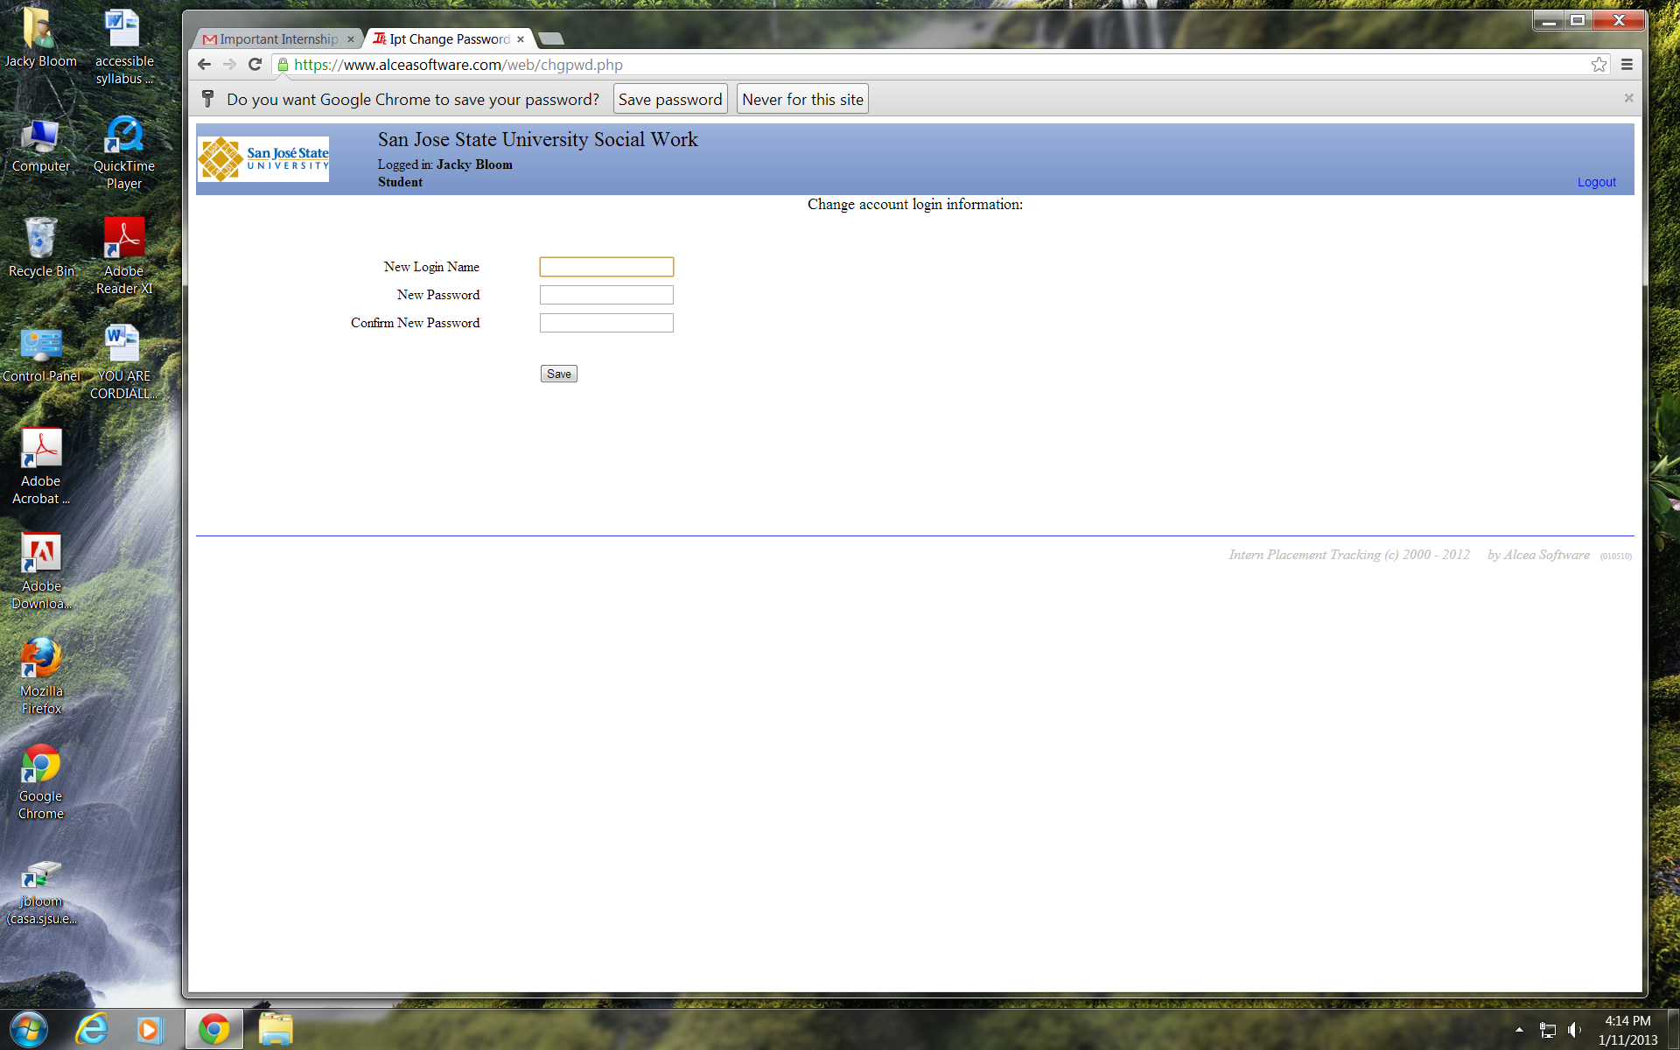
IPT sign in

Slide 47
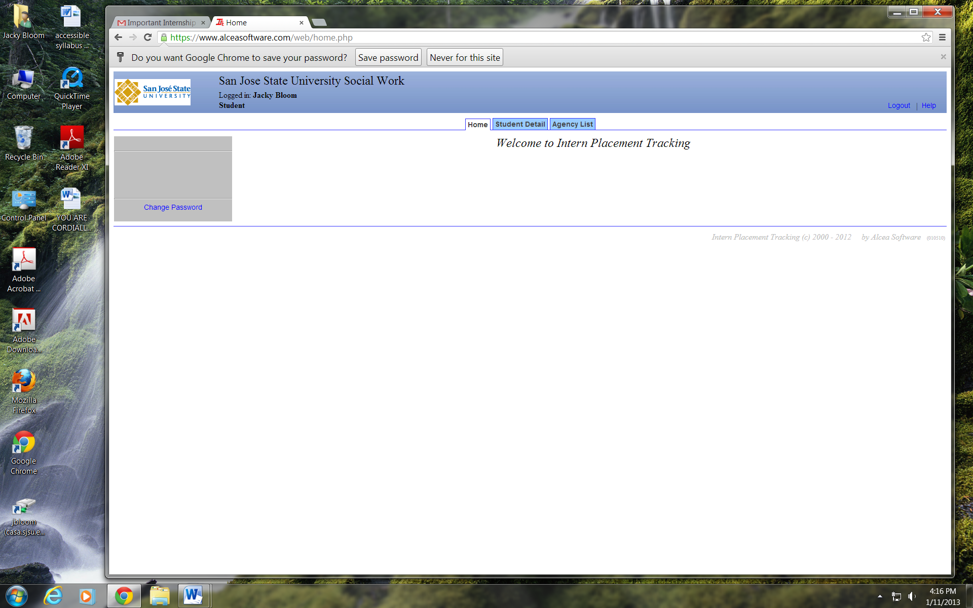
IPT

Slide 48
IPT Demonstration
https://www.alceasoftware.com/web/login.php

Slide 49
Thrills and Chills of Supervising
Structuring and Conducting Successful Supervision and Developmental Phases of Internships
Managing Challenging Students and Agency Environments

Slide 50
Thinking About OUR Field Instructor(s)
What qualities of your FI made your learning experience meaningful and effective?
What qualities/characteristics of FIs and/or the agency (in general) make learning challenging or less effective?

Slide 51
Field Instructor Roles
Education – assisting students to develop skills and professional competence
Management/Administration – assign work, promote standards of work, implement agency policies, monitor and evaluate
Support – create an environment that supports learning and growth, help students manage anxiety

Slide 52

Research indicates that the quality of the field instruction is the most significant factor affecting the satisfaction with the field placement (Fortune & Abramson, 1993)

Slide 53
Qualities of Successful Supervision
Supervision is regular and frequent, informal supervision is available as needed
Field Instruction happens in a context that provides emotional support and critical feedback
The Field Instructor provides both structure and autonomy
The Field Instructor is available, interested, and supportive (Bogo, 2010)

Slide 54
Realistic Expectations Support Successful Supervision
Supervision is a learning partnership – be clear and upfront about your expectations
Mistakes are learning opportunities and challenges are expected
Students are adult learners and should be expected to behave in a professional manner, come prepared for supervision, under supervision offer appropriate treatment to clients, take initiative to resolve disputes

Slide 55
Good Boundaries Facilitate Supervision
Boundaries are the overt and covert rules that students and field instructors internalize about the limits of their relationships.
Boundaries help students and field instructors feel respected and safe. Boundaries support the creation of positive, professional relationships in the education process.

Slide 56
More about Boundaries:
Set clear expectations at the beginning of field instruction and adhere to them
Suggest/refer students to therapy if they need more then supervision
Ask for help. (FFL and/or colleagues)
Be mindful of and avoid dual relationships (as much as possible)
Be mindful of favoritism
Model good boundaries in your professional relationships

Slide 57
Selected Supervision Guidelines
Supervision is not therapy, however, support is a crucial element of field instruction. Support involves encouragement, helping students identify growth and learning, being warm, and creating a safe environment to reveal and discuss mistakes. It is not diagnosing, making the focus of supervision the student’s issues or working on the student’s personal rather than professional goals.
Student’s personal issues should only be discussed in the context of its impact on their work in the agency and their learning.

Slide 58
Selected Supervision Guidelines
Teach students how to practice social work, not to do a particular job.
Help students learn to use social work skills effectively and to use knowledge and values to inform practice.
Teach skills including engaging clients, assessment, intervention and evaluation from a transcultural perspective to diverse students.
Evaluate skills through observing them not just by self report.

Slide 59
Structuring Supervision
Have an agenda, and create it in partnership with student
Use the internship checklist to structure early meetings
Learning Agreement is the basis of evaluation
Keep focus on the development of competencies
Attend to, but do not let pressing issues consume supervision sessions
Include: risk and safety, ethics and values, agency dynamics, history, protocols and policies, review documentation, challenges and successes in learning, resources, professional development, theoretical frameworks, transference and countertransference, class content, and self-care

Slide 60
Structuring Supervision Continued
If creating a formal agenda for each week does not work for you, use a more general checklist
Be available for informal supervision outside of supervision hour
Backup supervision when Field Instructor is away
Document supervision meetings, topics discussed and any agreements made

Slide 61
Field Instructor Supervision Notes:
field instructor supervision notes.docx

Slide 62

Considerations When Supervising Students
  Level of personal/life experience
  Level of professional experience
  Individual characteristics and backgrounds
  Differences in learning styles
  Differences in communication styles
  Attachment
  Stages of Internship

Slide 63
Developmental Stages of Internships
Stage One: Arranging and Anticipating an Internship
Stage Two: Orientation and Establishing Identity
Stage Three: Reconciling Expectations with Reality
Stage Four: Productivity and Independence
Stage Five: Closure
Stage Six: Re-Entry and Practical Applications
  Adapted from "The Internship as Partnership: A Handbook for Campus-Based Coordinators and Advisors," edited and published by the National Society for Experiential Education, 1995 via Washington State University Webpage.

Slide 64
Focus of Supervision Changes Over Time:
Stage One: Arranging and Anticipating an Internship – corresponds with the stage of preparing yourself and the agency for the intern’s arrival
Stage Two: Orientation and Establishing Identity – corresponds with explaining roles, setting boundaries, getting to know the student, and writing a learning agreement
Stage Three: Reconciling Expectations with Reality – corresponds with building and deepening the professional relationship, focus on skill building, and understanding obstacles and challenges

Slide 65
Focus of Supervision Changes Over Time (cont’d):
Stage Four: Productivity and Independence – corresponds with critical thinking and conceptualizing, building self-awareness, evaluating, increasing autonomous practice, and integrating theory and practice
Stage Five: Closure – corresponds with clarifying skill development, reviewing progress, managing transitions, and good byes
Stage Six: Re-Entry and Practical Applications – corresponds with supporting professional development and job seeking

Slide 66
Attend to Liability Issues:
Student Status
Appropriate Intervention
Confidentiality
Protection of Third Parties
Prevention of Suicide
Referring Clients to Specialists
Professional Misconduct
Mandated Reporting

Slide 67
Minimizing Liability
Assessment of student’s abilities and progress
Back-up Supervision
Written policies for risk/safety
Orientation and review of confidentiality and mandated reporting
Prepare students to inform clients of student status
Address ethical conflicts and values
Documentation
Provide adequate orientation and safety training
Notes:
Create a safe environment for students to discuss challenges and ask questions.

Slide 68
Proof of Liability Insurance (SJSU)
http://www.sjsu.edu/socialwork/docs/2013-2014%20SPLIP%20Certificate.pdf

Slide 69
Managing Challenges
Common or individual experiences or strategies you have used with specific students?

Slide 70
Managing Challenging Students – Ideas to Keep in Mind
Some level of challenges is likely
Most students with problematic behaviors complete their internships successfully
Student challenges provide opportunities for Field Instructor growth
Most Important – address issues as they arise, ask for help, don’t personalize

Slide 71
Steps for Managing Challenging Students
Identify the problem and discuss with the student (it will not go away on it’s own)
Ask for help (FFL and colleagues)
Explain to the student why it’s a problem
Help the student strategize how to manage the problem
Ask for help
Check out your own process
Ask for help

Slide 72
When a student is in crisis:
Use crisis intervention model
Make sure that the student and their clients are safe.
What needs to happen initially/in the short term for student and his or her clients
What is the longer range plan for student and clients
Ask for help (early and often)

Slide 73
When the Challenge is the Agency Environment
Practice self-care (it’s also good modeling for your intern)
Seek support for yourself, just not from the student
Consider whether the FFL or Field Education Office can assist you regarding needs and/or supports for your student
Stay upbeat with your student – field instruction is an opportunity have a positive impact on student(s) and shape his or her lifetime of practice
Use strategies that work for you to stay focused
Act as if (fake it until something changes)

Slide 74
Hints and Tips for New FIs
What do you wish you had known before supervising for the first time?
What did your most challenging student teach you?
Any other hints or tips?

Slide 75
Panel: Field Instructors, Faculty, and Students
What field instruction practices have you found:
  To be especially successful
  Not so great/what not to do
  What do you wish you had known when you became a field instructor/what do wish your FI (s) had known or done?
  For Dr. Sen - Questions regarding Transcultural Practice or Theory?

Slide 76

Wrap-up and Questions

Slide 77
References:
Marion Bogo – Achieving Competence Through Field Education, 2010
Fortune, A. E., & Abramson, J. S. (1993). Predictors
of satisfaction with Held practicum among
social work students. The Clinical Supervisor,
11,95-110.

